Slide 1
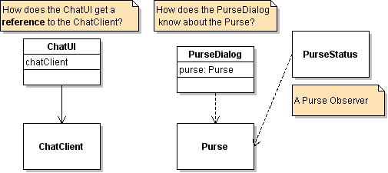
How do Objects "know" other Objects?

Slide 2
Getting a Reference to Another Object
Beginners often create objects whenever they need a reference:
public class PurseDialog {
public void run( ) {
Purse purse = new Purse(10);
...
}

Slide 3
Getting a Reference to Another Object
But this is not a flexible design.
And it doesn't work if two objects need to refer to the same Purse.
PurseDialog
creates
Purse
PurseDialog
Purse
PurseObserver

Slide 4
Dependency Injection
A flexible solution is to tell the PurseDialog what Purse object to use.
1. PurseDialog needs a Purse attribute so it can remember the Purse.
class PurseDialog {
private Purse purse; // initially null

Slide 5
2. "Set" the Dependency
2.1 Constructor parameter.
Advantage: guarantees that the purse will be set at start.
class PurseDialog {
private Purse purse; // initially null
public PurseDialog(Purse apurse) {
this.purse = apurse;
}
2.2 Setter method.
Advantage: can set or change the Purse at any time.
public void setPurse(Purse apurse) {
this.purse = apurse;
}

Slide 6
Dependency Injection
These designs are call dependency injection.
They are one solution to the problem of how to connect objects together ... but not too tightly.
PurseDialog
-purse: Purse
+setPurse(Purse)
Purse
PurseDialog depends on Purse, but Purse does not depend on PurseDialog.

Slide 7
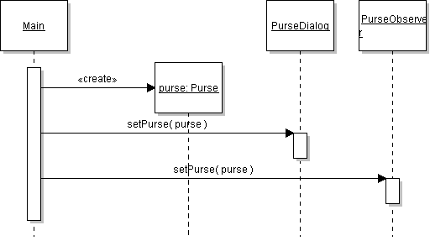
Dependency Injection with Many Object
Easy to apply when two objects need reference to the same Purse:

Slide 8
Strategies
Strategies are behavior which is delegated to another object. Typical uses of strategy are:
1. there is more than one way to implement some behavior, and we'd like to be able to change it.
Example: there's more than one algorithm for withdrawing Money from a Purse. We might need to change it if the kinds of Money change.
2. many classes need the same behavior. Instead of duplicating the code in every class, we separate behavior from the class so we can reuse it.
Example: Swing containers all need a layout manager. Instead of duplicating layout code in JFrame, JPanel, JWindow, etc., we create layout classes (BorderLayout...)

Slide 9
Situation Calling for Strategy
Class X
Design Goals
1. High cohesion
2. Open for extension (extend w/o editing class X)
3. Easy to change
4. Reusable
update( )
doA( )
doB( )
doA may need to change!

Slide 10
Create a Strategy... and use it
Class X
Separate what can vary from what stays the same.
update( )
doA( ) {
aStrategy.doA(this);
delegate to another object
AStrategy
doA( X x )
doB( )

Slide 11
Make a Family Interchange Strategies
Class X
Define an interface for desired behavior
update( )
interface AStrategy {
void doA(X x);
}
doA( ) {
AStrategy.doA( );
delegate to another object
MyAStrategy {
doA(X x) { my way }
}
doB( )

Slide 12
Set the Strategy in the Context
Class X
Define interface for desired behaviro
update( )
interface AStrategy {
void doA( );
}
doA( ) {
AStrategy.doA( );
// delegate to strategy object
MyAStrategy {
doA() { my way }
}
setAStrategy( a ) {
this.aStrategy = a;
}

Slide 13
Strategy Example: Sorting
class Collections {
sort( list );
sort( ) is a reusable algorithm.
calls
compare(a,b ) is a strategy for comparing objects. There may be more than one way to compare same objects.
compare(a,b)

Slide 14
Put compare( ) in a separate object
Collections {
Define interface for strategy's behavior.
sort( list, Comparator x );
<<interface>>
Comparator
+compare(a,b): int
Here there isn't a separate "setStrategy" method. The strategy is a parameter to sort.
MyComparator
compare(a,b)
Create implementation according to your app.

Slide 15
Sorting with builtin (default) Strategy
Collections {
sort( list<X> );
X implements Comparable {
If you don't specify a strategy for sorting, sort() uses the object's own compareTo method.
This "default strategy" is called the natural order.
compareTo(b)
A strategy for ordering objects from this class.

Slide 16
What Design Principles
Does Strategy Use?
1. Separate what varies from what stays the same.
2. Program to an interface, not an implementation.
3. Open-closed Principle.
Class X
doA( ) {
aStrategy.doA(this);
// delegate to strategy object
interface AStrategy {
void doA( );
}
setAStrategy( a ) {
this.aStrategy = a;
}

Slide 17
How to Get a Logo?
Problem:
1) many objects want to show the KU logo
2) we don't want to create lots of image
3) the image is BIG. Don't create it if not needed.
class KUframe extends JFrame {
ImageIcon kulogo;
void initComponents() {
kulogo = new ImageIcon(
this.getClass.getResource("kulogo") );.
add(new JLabel( kulogo ) );

Slide 18
Factory: not a solution
class LogoFactory {
static final String filename = "images/kulogo.gif":
public static ImageIcon getLogo() {
// get class loader from Class name
ClassLoader loader =
LogoFactory.class.getClassLoader();
return new ImageIcon( loader.getResource(filename) );
}
}
This creates a new image each time getLogo() is called.

Slide 19
Singleton with eager instantiation
This is better, but we have to wait at start-up time for large image to load.
class LogoFactory {
static final String filename = "images/kulogo.gif":
private static ImageIcon image;
static { // this code block is executed when class is loaded
ClassLoader loader =
LogoFactory.class.getClassLoader();
image = new ImageIcon(loader.getResource(filename) );
}
public static ImageIcon getLogo() {
return image;
}
}
Singleton object

Slide 20
Lazy Instantiation
Don't do the work until someone asks for it. Maybe they will never ask!
class LogoFactory {
static final String filename = "images/kulogo.gif":
private static ImageIcon image;
public static ImageIcon getLogo() {
// create icon object the first time
if (icon == null) image = makeLogo( );
return image;
}
private ImageIcon makeLogo( ) {
ClassLoader loader =
LogoFactory.class.getClassLoader();
return new ImageIcon(loader.getResource(filename) );
}
Create the image the first time someone calls getLogo( ).

